Slide 1
EECS E6895 - Progress 1 COVID-19 Risk Prediction via Bayesian Network
A11: Reasoning (Understanding Causalities via Bayesian Network and/or others)
Yiwen Fang (yf2560) | Guoshiwen Han (gh2567)

Slide 2
Data collection
Structured node & primary code
Issues on Data
Frontend / UI
Q & A

Slide 3
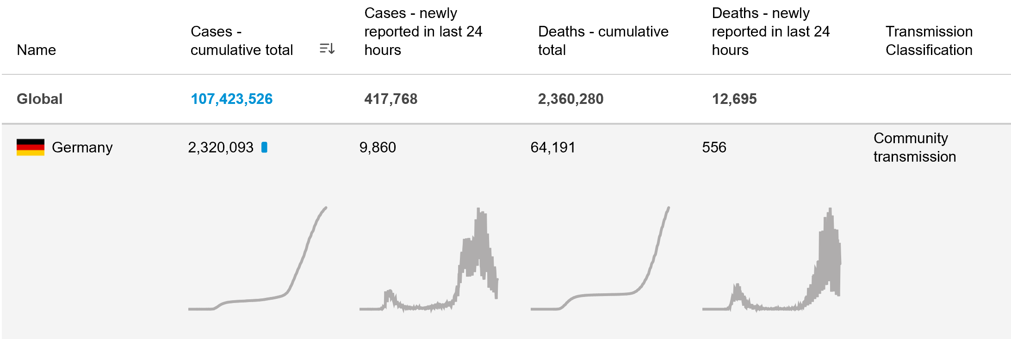
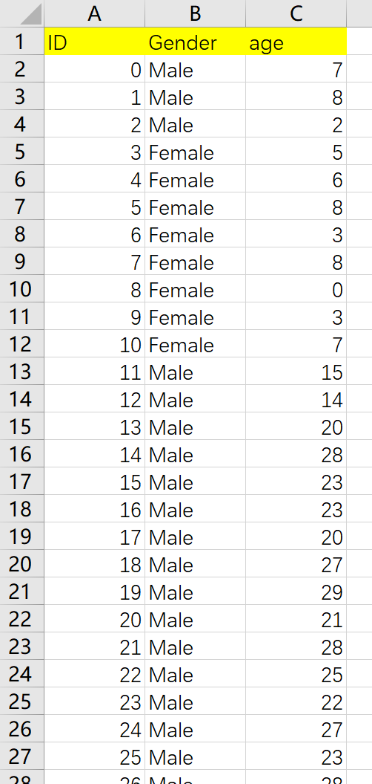
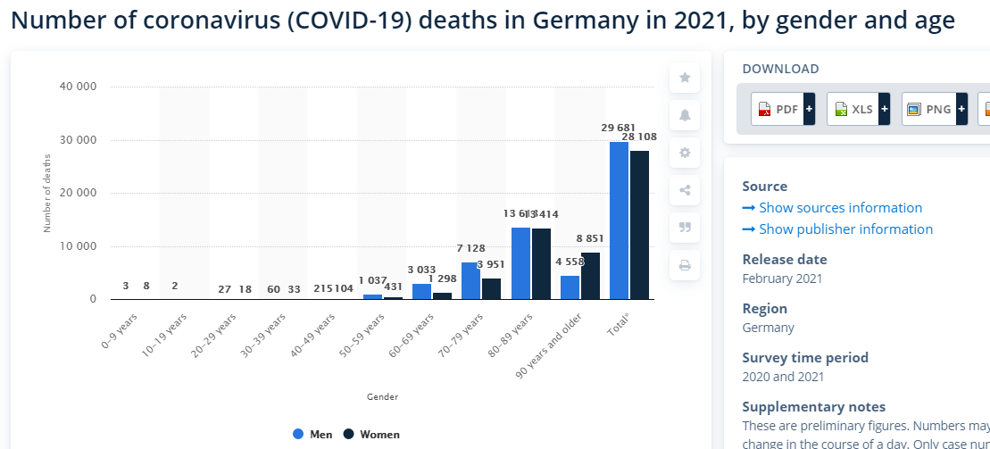
Data collection Take Germany as an example. We get the confirmed cases from WHO, and gender and age distributions
Source: https://covid19.who.int/table
https://www.statista.com/statistics/1105512/coronavirus-covid-19-deaths-by-gender-germany/

Slide 4
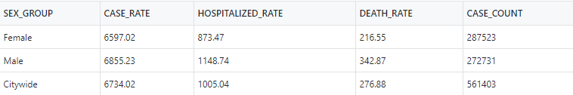
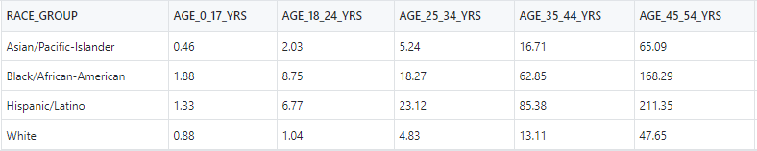
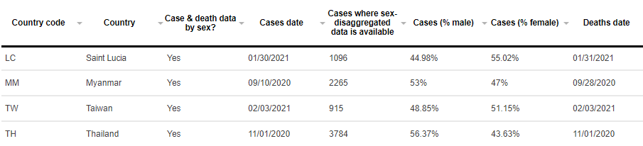
Issues on data Three issues on manipulating data: coverage of areas, co-existence of attributes, and destruction of summarized data
Situation
Sample Data
Coverage of Areas
The comprehensive COVID-19 data, with compulsive attributes for Bayesian network, may not be available for all the countries, states, provinces, cities
Co-existence of Attributes
The conditional probabilities in Bayesian network require the co-existence of attributes in the dataset
Destruction of Summarized Data
Ideally the training dataset needs a set of individual data entries
The individual dataset must be reconstructed since COVID-19 only has summarized statistical dataset
Source: NYC Health Department
https://globalhealth5050.org/the-sex-gender-and-covid-19-project/dataset/

Slide 5
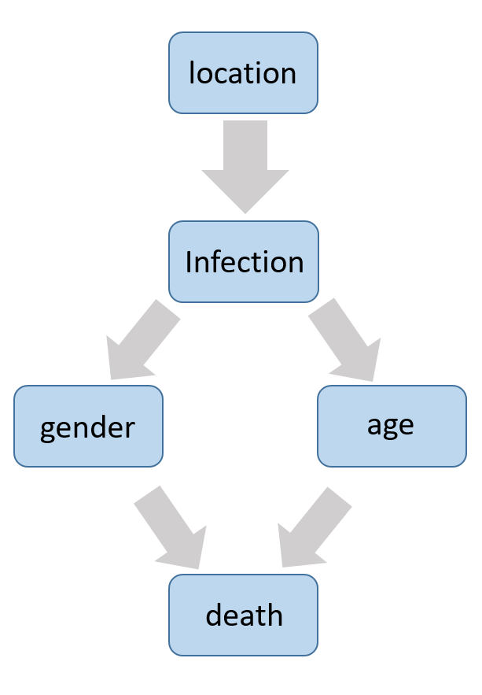
Structured node & primary code
from pgmpy.models import BayesianModel from pgmpy.estimators import BayesianEstimator train = pd.read_csv('./train.csv') test = pd.read_csv('./test.csv') model = BayesianModel( [('location', 'infection'), ('infection', 'gender'), ('infection', 'age'), ('Age', 'death'), ('Gender', 'death’)])

Slide 6
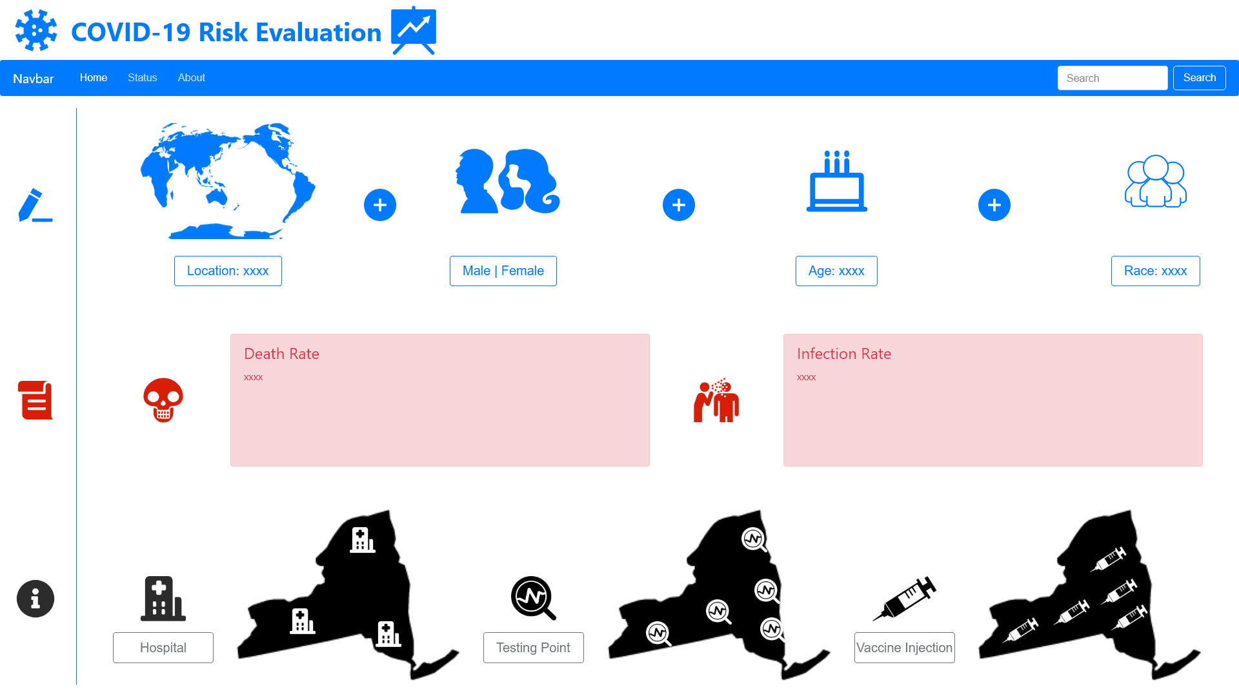
Frontend / UI

Slide 7
Q & A

